Slide 1



8th International BCI Meeting 2021: Workshop W3 ‘‘Optimising BCI performance by integrating information on the user's internal state’’
User-Centered Design Metrics and
Motivational Aspects for Basic Study Design
Philipp Ziebell
University of Würzburg – Institute for Psychology
Psychological Intervention, Behavior Analysis, and Regulation of Behavior
(Prof. Dr. Andrea Kübler)
Differential Psychology, Personality Psychology, and Psychological Diagnostics
(Prof. Dr. Johannes Hewig)

Slide 2
User-Centered Design Metrics and Motivational Aspects for Basic Study Design
Philipp Ziebell – University of Würzburg
1 / 10
User-Centered Design (UCD): A Step-by-Step Process (as explained by Angela)
User-Centered Design Metrics
Motivational Aspects
Focus of this talk
Study Design:
Methods
Study Design:
Results
Q & A
Kübler, A., Nijboer, F., & Kleih, S. (2020). Hearing the needs of clinical users. In Ramsey, N. F. & Millán, J. R. (Eds.), Handbook of Clinical Neurology. Amsterdam: Elsevier.
Kübler, A., Holz, E. M., Riccio, A., Zickler, C., Kaufmann, T., Kleih, S. C., …, & Mattia, D. (2014). The user-centered design as novel perspective for evaluating the usability of BCI-controlled applications. PLoS ONE, 9(12), doi: 10.1371/journal.pone.0112392.

Slide 3
User-Centered Design Metrics and Motivational Aspects for Basic Study Design
Philipp Ziebell – University of Würzburg
2 / 10
Overview
User-Centered Design Metrics
Motivational Aspects
Focus of this talk
Study Design:
Methods
Study Design:
Results
Q & A
See supplements for detailed information.
Kübler, A., Nijboer, F., & Kleih, S. (2020). Hearing the needs of clinical users. In Ramsey, N. F. & Millán, J. R. (Eds.), Handbook of Clinical Neurology. Amsterdam: Elsevier.
Kübler, A., Holz, E. M., Riccio, A., Zickler, C., Kaufmann, T., Kleih, S. C., …, & Mattia, D. (2014). The user-centered design as novel perspective for evaluating the usability of BCI-controlled applications. PLoS ONE, 9(12), doi: 10.1371/journal.pone.0112392.

Slide 4
User-Centered Design Metrics and Motivational Aspects for Basic Study Design
Philipp Ziebell – University of Würzburg
3 / 10
Overview
User-Centered Design Metrics
Motivational Aspects
Study Design:
Methods
Study Design:
Results
Q & A
See supplements for detailed information.
Focus of this talk
Chavarriaga, R., Fried-Oken, M., Kleih, S., Lotte, F., & Scherer, R. (2017). Heading for new shores! Overcoming pitfalls in BCI design. Brain-Computer Interfaces, 4, doi: 10.1080/2326263X.2016.1263916.
Lotte, F., Larrue, F. & Mühl, C. (2013). Flaws in current human training protocols for spontaneous Brain-Computer Interfaces: lessons learned from instructional design. Frontiers in Human Neuroscience, 7, doi: 10.3389/fnhum.2013.00568.

Slide 5



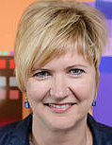


User-Centered Design Metrics and Motivational Aspects for Basic Study Design
Philipp Ziebell – University of Würzburg
4 / 10
Example
User-Centered Design Metrics
Motivational Aspects
Study Design:
Methods
Study Design:
Results
Q & A
Ziebell, P., Stümpfig, J., Eidel, M., Kleih, S. C., Kübler, A., Latoschik, M. E., & Halder, S. (2020). Stimulus modality influences session-to-session transfer of training effects in auditory and tactile streaming-based P300 brain–computer interfaces. Scientific Reports, 10(1), doi: 10.1038/s41598-020-67887-6.

Slide 6
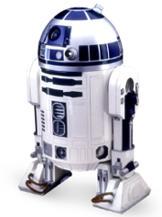


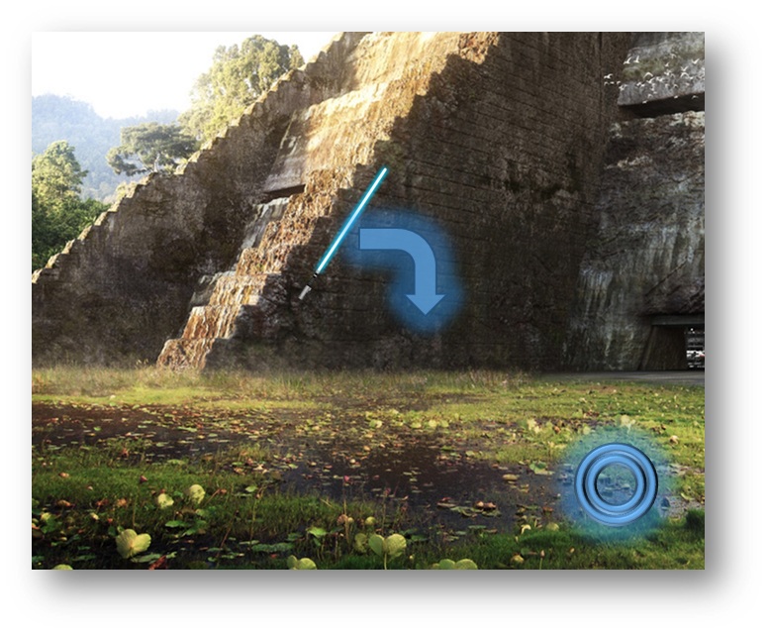
User-Centered Design Metrics and Motivational Aspects for Basic Study Design
Philipp Ziebell – University of Würzburg
5 / 10
Task, Feedback, and Instructions
User-Centered Design Metrics
Motivational Aspects
Motivational Aspects
Study Design:
Methods
Study Design:
Results
Q & A
Ziebell, P., Stümpfig, J., Eidel, M., Kleih, S. C., Kübler, A., Latoschik, M. E., & Halder, S. (2020). Stimulus modality influences session-to-session transfer of training effects in auditory and tactile streaming-based P300 brain–computer interfaces. Scientific Reports, 10(1), doi: 10.1038/s41598-020-67887-6.

Slide 7
User-Centered Design Metrics and Motivational Aspects for Basic Study Design
Philipp Ziebell – University of Würzburg
6 / 10
Training Protocol
UCD Metrics
Motivational Aspects
User-Centered Design Metrics
Motivational Aspects
Study Design:
Methods
Study Design:
Results
Q & A
Ziebell, P., Stümpfig, J., Eidel, M., Kleih, S. C., Kübler, A., Latoschik, M. E., & Halder, S. (2020). Stimulus modality influences session-to-session transfer of training effects in auditory and tactile streaming-based P300 brain–computer interfaces. Scientific Reports, 10(1), doi: 10.1038/s41598-020-67887-6.

Slide 8
User-Centered Design Metrics and Motivational Aspects for Basic Study Design
Philipp Ziebell – University of Würzburg
7 / 10
Objective UCD Metrics
Online-Accuracy (UCD effectiveness) and ITR (UCD efficiency) can provide valuable complementary information...
…, same goes for depiction of individual profiles (e.g. dropouts could be prevented).
User-Centered Design Metrics
Motivational Aspects
Study Design:
Methods
Study Design:
Results
Q & A
Ziebell, P., Stümpfig, J., Eidel, M., Kleih, S. C., Kübler, A., Latoschik, M. E., & Halder, S. (2020). Stimulus modality influences session-to-session transfer of training effects in auditory and tactile streaming-based P300 brain–computer interfaces. Scientific Reports, 10(1), doi: 10.1038/s41598-020-67887-6.

Slide 9
User-Centered Design Metrics and Motivational Aspects for Basic Study Design
Philipp Ziebell – University of Würzburg
8 / 10
Subjective UCD Metrics
NASA-TLX (UCD efficiency) and VAS (UCD efficiency, UCD satisfaction) can provide valuable complementary information…
…, same goes for non-significant trends.
User-Centered Design Metrics
Motivational Aspects
Study Design:
Methods
Study Design:
Results
Q & A
Ziebell, P., Stümpfig, J., Eidel, M., Kleih, S. C., Kübler, A., Latoschik, M. E., & Halder, S. (2020). Stimulus modality influences session-to-session transfer of training effects in auditory and tactile streaming-based P300 brain–computer interfaces. Scientific Reports, 10(1), doi: 10.1038/s41598-020-67887-6.

Slide 10
User-Centered Design Metrics and Motivational Aspects for Basic Study Design
Philipp Ziebell – University of Würzburg
9 / 10
Motivational Aspects
User-Centered Design Metrics
Motivational Aspects
Study Design:
Methods
VAS and QCM-BCI can provide valuable complementary information…
…, same goes for non-significant trends…
… as well as the open questions for concluding remarks (qualitative data / “mini interview”).
Study Design:
Results
Q & A
Ziebell, P., Stümpfig, J., Eidel, M., Kleih, S. C., Kübler, A., Latoschik, M. E., & Halder, S. (2020). Stimulus modality influences session-to-session transfer of training effects in auditory and tactile streaming-based P300 brain–computer interfaces. Scientific Reports, 10(1), doi: 10.1038/s41598-020-67887-6.

Slide 11
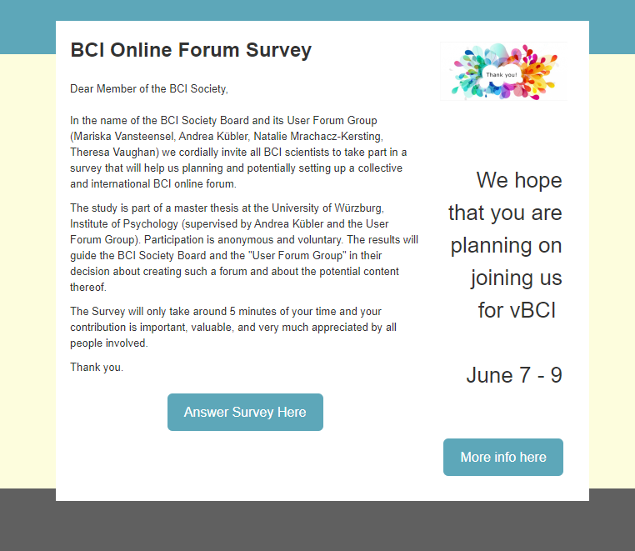
User-Centered Design Metrics and Motivational Aspects for Basic Study Design
Philipp Ziebell – University of Würzburg
10 / 10
Thank You!
See supplements for detailed information.
User-Centered Design Metrics
See also poster 2-D-11: „Introducing Tactile P300 Brain-Computer Interfaces to a Locked-In Syndrome Patient with Amyotrophic Lateral Sclerosis“
Motivational Aspects
Study Design:
Methods
See also poster 3-D-12: „Moving Closer to Application: ALS Patients Control a Virtual Wheelchair Using a Tactile Brain-Computer Interface “
Study Design:
Results
Q & A
https://www.soscisurvey.de/bciforum/

